Slide 1
Analyzing the Impact of Financial Stability and Family Structure on Elder Health: A Machine Learning Approach Using the RAND HRS Longitudinal File 2020
Yuzhen Zhou, Zeyuan Pang

Slide 2
Objectives & Motivations
Background: Serious aging population in East Asia.
Analyze the impact of financial stability and family structure on the health outcomes.
Provide evidence-based insights to guide policy making in healthcare, social security, and family support initiatives, thereby facilitating more effective strategies to aid older adults.

Slide 3
Data Preprocessing
Data Source: RAND HRS Longitudinal 2020
Data Preprocessing:
Selected 20 features
Dropped the NA rows and deleted two meaningless features
After data cleaning our dataset has 38488 rows
Assign groups by unique combination of binary categorical features
Detect outliers by groups

Slide 4
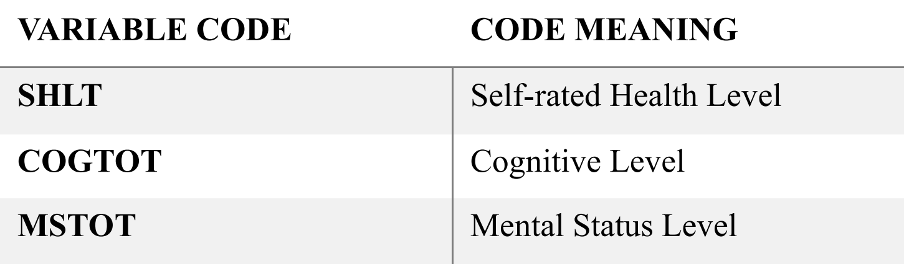
Target Features

Slide 5
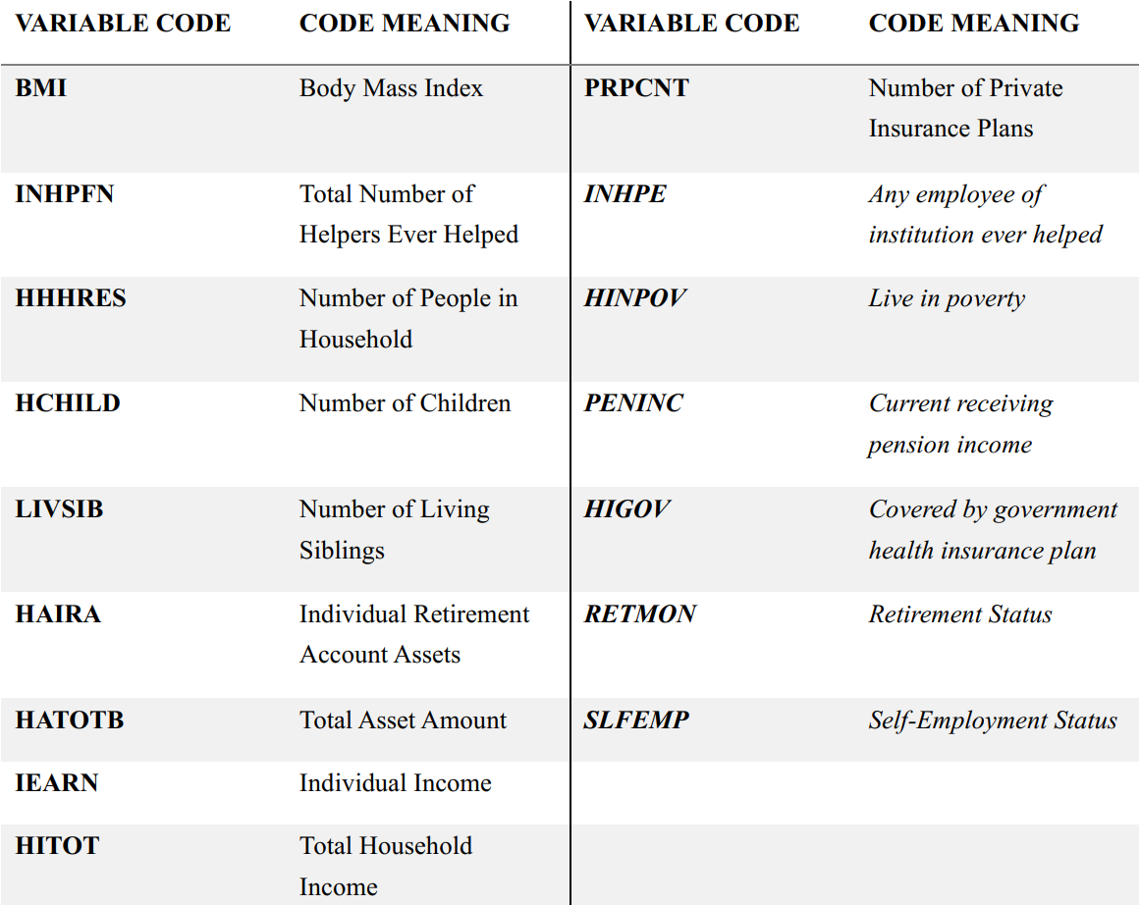
Input Features

Slide 6
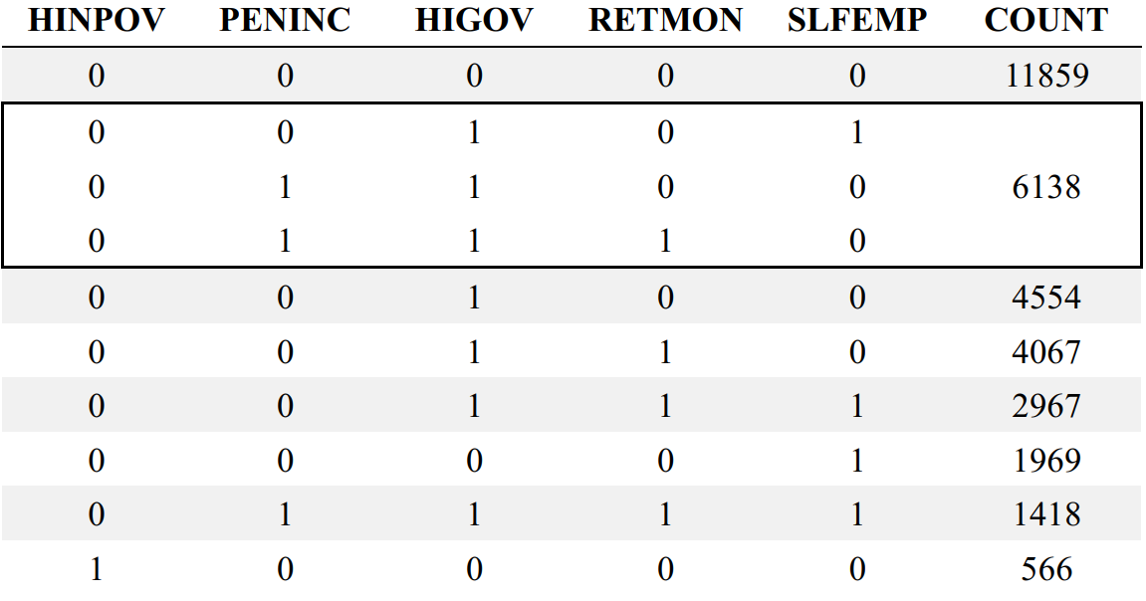
Groups Encoding

Slide 7
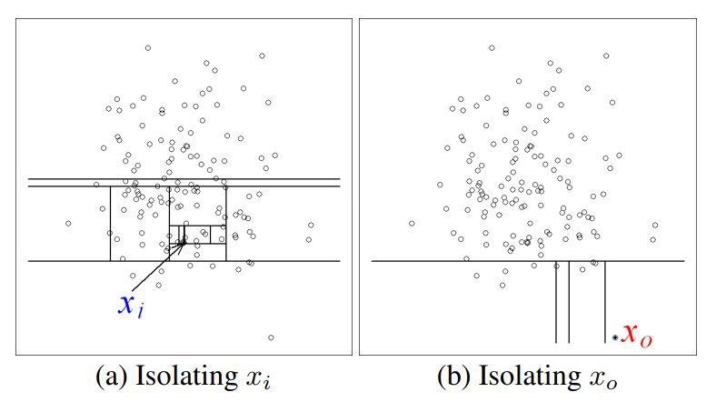
Outlier Detection
Isolation forest by groups.
10% of total points
Groups with few samples (< 500).

Slide 8
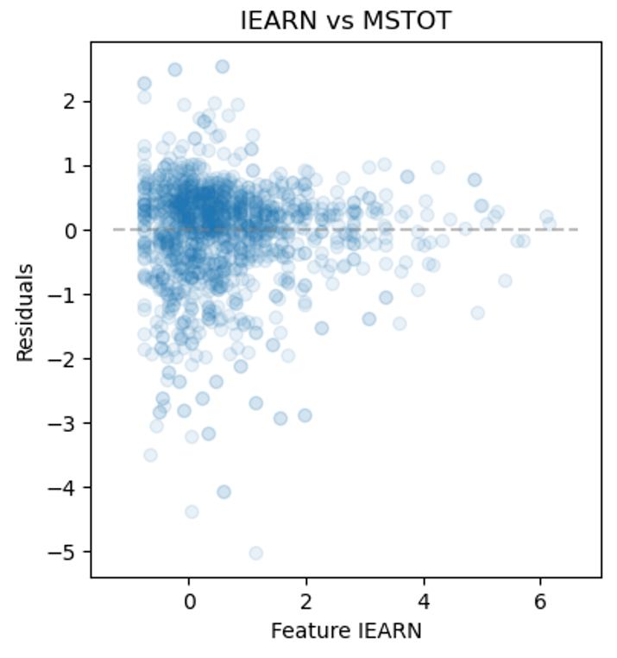
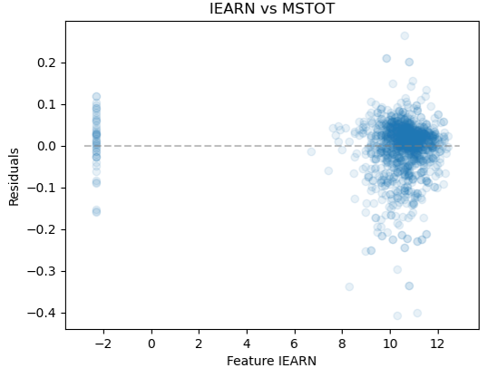
Log Transformation
To solve heteroskedasticity
Restrict the logarithmic transformation to features excluding “HATOTB” since it contains negative data with substantially large absolute values

Slide 9
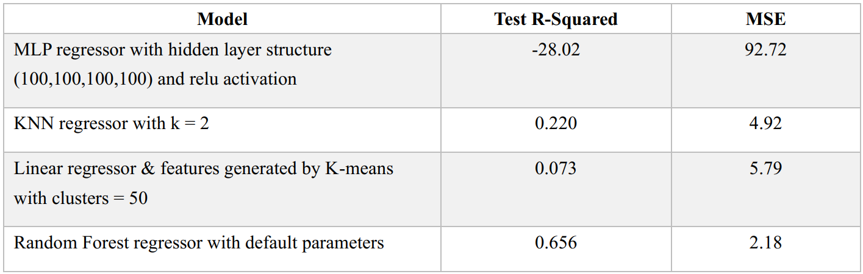
Baseline Models

Slide 10
Training
Train models by group
Split each group into train and test with the ratio 9:1
Grid search with 10-fold cross validation in training data
Evaluate performance on test set
Metrics : R-squared, RMSE, MAPE

Slide 11
Performance
Group | Train R^2 (avg) | Test R^2 (avg) | Train RMSE | Test RMSE | Train MAPE | Test MAPE
0,0,0,0,0 | 0.692483 | 0.748598 | 0.016695 | 0.046585 | 0.003745 | 0.010571
0,0,0,0,1 | 0.653973 | 0.790487 | 0.017321 | 0.042677 | 0.00384 | 0.010011
0,0,1,0,0 | 0.682798 | 0.729988 | 0.017791 | 0.056201 | 0.003956 | 0.012163
0,0,1,0,1 + 0,1,1,0,0 + 0,1,1,1,0 | 0.677 | 0.787799 | 0.016235 | 0.040685 | 0.003603 | 0.009468
0,0,1,1,0 | 0.681261 | 0.731047 | 0.016531 | 0.046394 | 0.003701 | 0.010611
0,0,1,1,1 | 0.674078 | 0.742469 | 0.017445 | 0.046525 | 0.003803 | 0.010676
0,1,1,1,1 | 0.647207 | 0.816367 | 0.016529 | 0.037547 | 0.003643 | 0.008737
1,0,0,0,0 | 0.524486 | 0.523801 | 0.025684 | 0.078733 | 0.006101 | 0.019442

Slide 12
Machine Learning Morphisms
ML1 is the grouping process
ML2 is the unsupervised Isolation Forest Algorithm
ML3 is the log transformation on continuous features.
ML4 is the Random Forest Regressor

Slide 13
Insights: Financial Stability
Importance of Individual Retirement Account Asset, Household Total Income, and Household Total Asset is prominent in all groups, especially in groups that with government health insurance
Higher finance-related feature value relates to higher lower bound of cognitive level and mental status level.
Implying that programs designed to increase financial literacy, asset building, and economic opportunities could indirectly contribute to better cognitive and mental health outcomes, especially in lower-income communities.

Slide 14
Insights: Financial Stability
Higher Individual Income also relates to higher lower bound of cognitive level and mental status level, but also relates to decreased upper bound of self-evaluated health level.
It might suggest that while individuals with higher earnings evaluate their health more critically, or they may be more aware of health issues due to better access to health care and thus report more health problems.
Also, higher-income individuals might have jobs that are more demanding, leading to increased stress and perceived worse health despite objectively better health metrics.

Slide 15
Insights: Financial Stability
For self-employed groups, the importance of Individual Income is relatively low, but the importance of Household Total Income and Household Total Asset is high.
It may because individual earnings may not capture the full economic picture as effectively as total household income or asset amount for self-employed individuals.
These observations suggest that the role of economic stability and variability in income should be considered when designing health policies or workplace wellness programs. For self-employed individuals, policies might need to focus more on providing stability and access to health resources.

Slide 16
Insights: Financial Stability
The significance of the Number of Private Insurance Plans is generally low. However, an observable correlation exists between this variable and the baseline mental status level across various groups, except for the group in poverty (1,0,0,0,0).
There may be a need to specifically target mental health support programs to individuals who have fewer private insurance plans, especially in economically disadvantaged groups.
Also, for poor groups like “1,0,0,0,0”, interventions may need to be more holistic, addressing not just health insurance coverage but also employment opportunities, income support, and other social services to improve overall well-being and mental health.

Slide 17
Insights: Family Structure
In group “0,0,1,1,1”, fewer than 2 children or exceeding 5 children in the household are associated with an elevated lower bound of mental status level. Additionally, surpassing 5 children in the household correlates with an increased lower bound of cognitive level.
Fewer children may mean fewer caretaking responsibilities and more resources per child, potentially reducing stress and allowing more focus on personal mental well-being. Conversely, a very large family might foster a supportive environment that can be mentally stimulating and emotionally fulfilling, contributing positively to cognitive and mental health.
Community and social programs that mimic the benefits of a large family could be beneficial. Programs that increase social interactions, provide community support, and engage them in mentally stimulating activities could replicate these benefits. Also, policies aimed at supporting retirees in maintaining an active lifestyle, whether through community involvement or family engagement, could be crucial.

Slide 18
Insights: Family Structure
The relationship between Mental Status Level and Number of People in Household on most retired groups agrees with the previous statement.
It could also because that individual stressors related to daily living or financial burdens may be diluted as responsibilities and resources are shared among more members with more people in the household.
Overall, it emphasizes the importance of social support systems and community programs that foster interaction and engagement among community members.

Slide 19
Conclusion: Achievement
This project highlight the strong influence of financial factors and family structures on health, especially mental health, and suggests policies improve health outcomes for the elderly, potentially leading to significant reductions in healthcare costs and improvements in life quality.

Slide 20
Conclusion: Difficulties
Data extraction
Heteroskedasticity in residuals

Slide 21
Conclusion: Modelling
Random Forest is convenient for complex data, and could be relatively accurate without much data preprocess. Its prediction process is also interpretable.
The stage of model selection can be enhanced by optimizing each model to its peak performance before making a selection.
Feature selection and hyperparameter tuning could benefit from the implementation of nested cross-validation.

